Slide 1
Speaking Of Dance
By
Shreya Singh (India)
APLP G10 GIST Delegate
Notes:
Good evening everybody. It is my pleasure to be your first presenter today. I am Shreya Singh from India and my research topic is on dance, not just any type of dance but classical dance, as I am a trained classical dancer myself.

Slide 2
Bharath-Natyam
Understanding teaching methods
What inspires a student?
Who is documenting these art forms?
Are they getting diluted?
Student count over the years

Slide 3
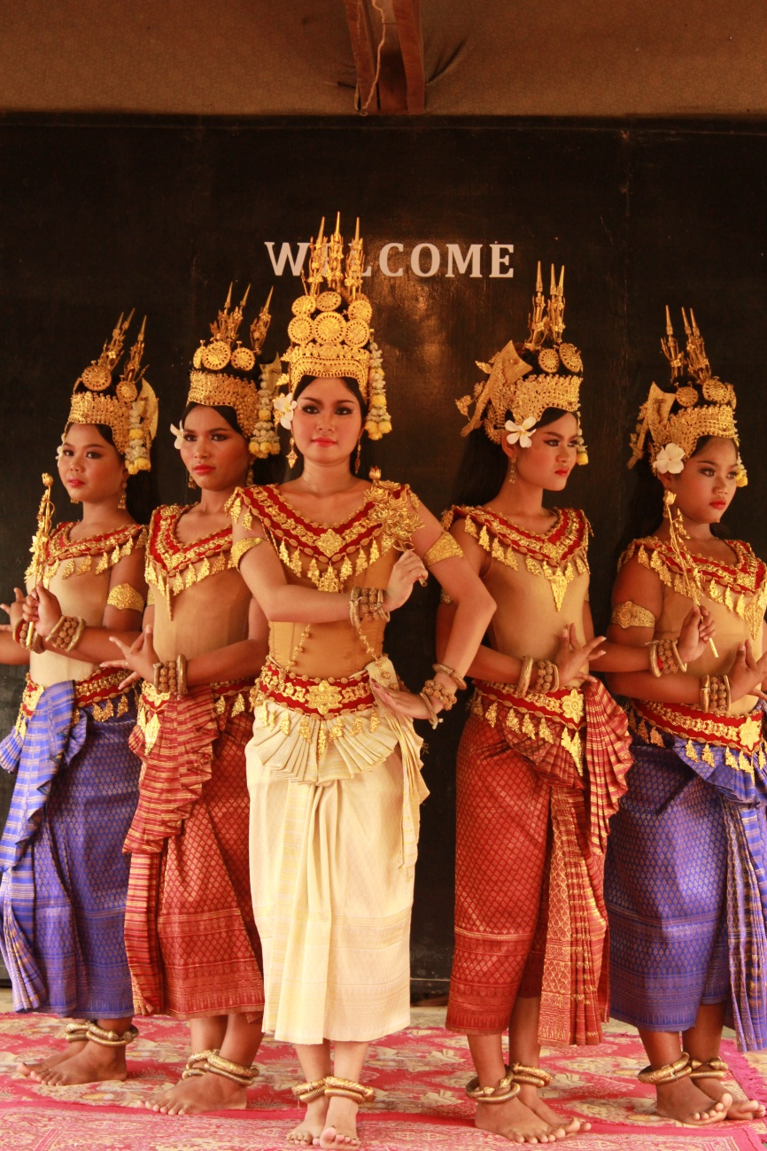
Cambodia and Indonesia

Slide 4
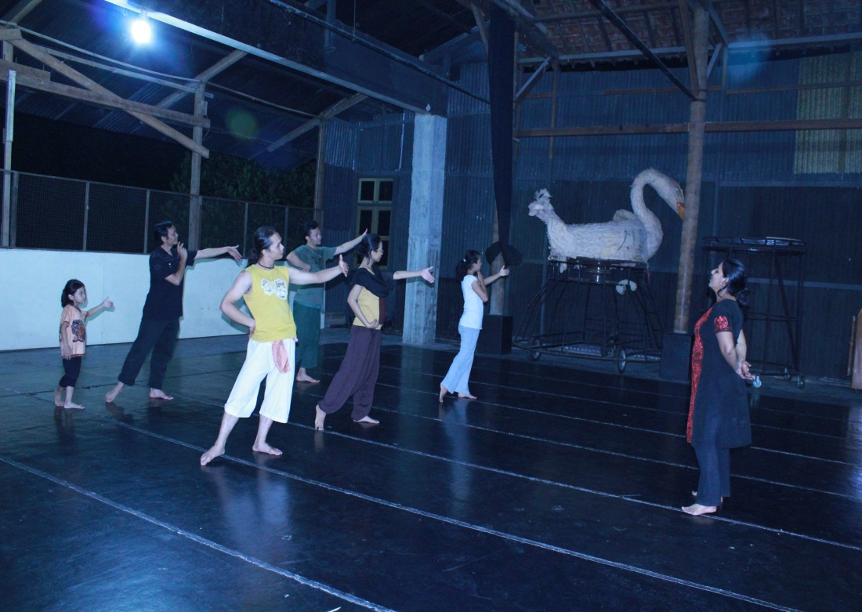
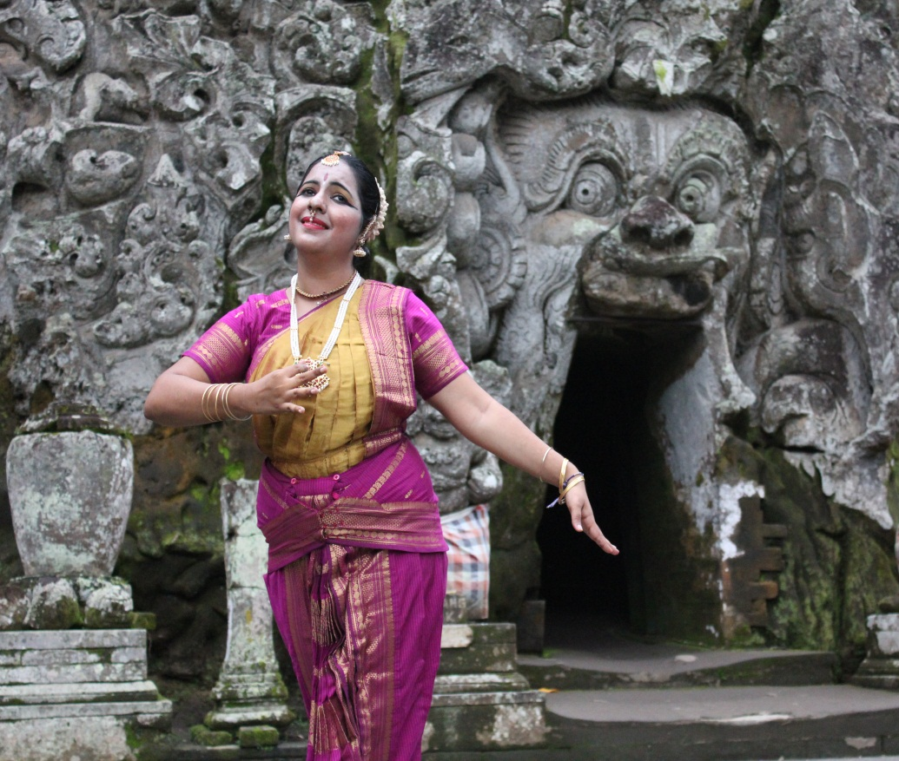
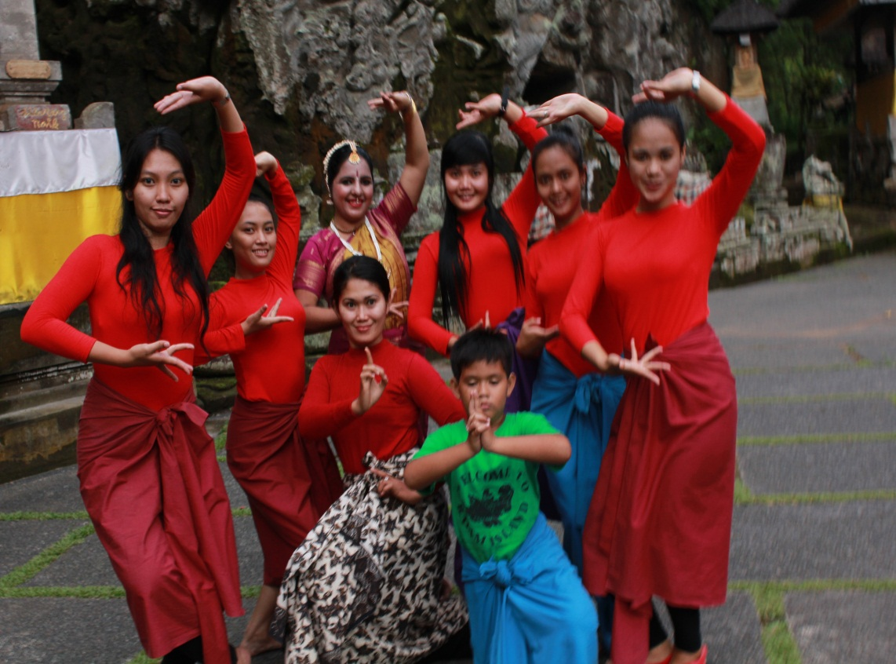

Slide 5
In three words…
Truth - India
Reality - Cambodia
Existence - Indonesia

